Slide 1

Airline Management System
Team No. 04

Slide 2
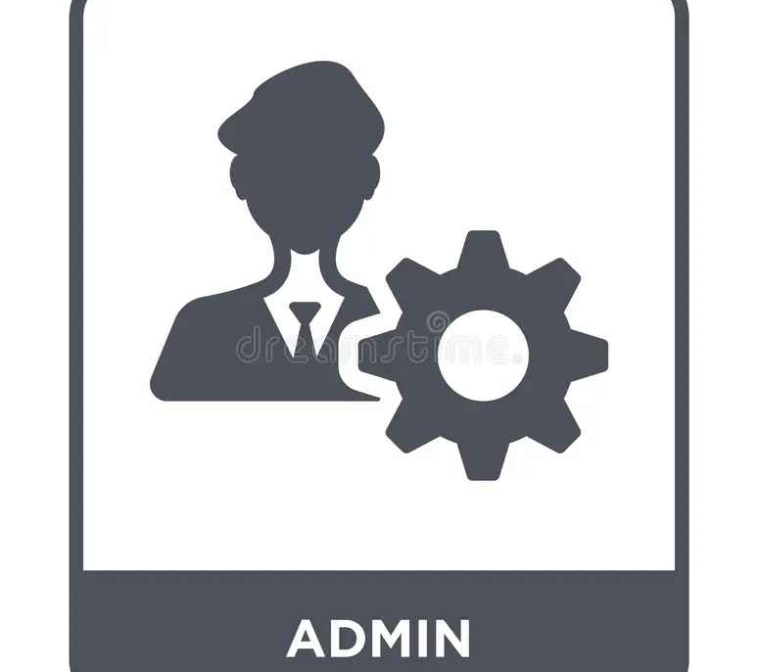

Module Specifications The airline reservation system has two main modules like Flight Scheduling, and ticket booking which will be handled by two major Parties (Admin, and Staff) of the application.
Admin
Staffs

Slide 3
Admin Features
Separate login page only accessible by Admin
Flight Scheduling Timetable & Price
-Add , Deletion / Removal of Staff Members
Admin page has the full authority for the system
- Customers Feedback

Slide 4
Staff Features
Separate login page for staffs
- Flight scheduling
- Customer registration
- Tickets booking
- Tickets cancellation

Slide 5
Page Interface
Login page for staffs and admins(separately)
Homepage;
Flight Scheduling
Customer Registration
Ticket Booking
Cancellation
- Customers Feedback

Slide 6
Software
The Application is built using JAVA (NetBeans).
MySQL database is using for store details.
The project is totally built for administrative end and admin and staffs can only access the system.

Slide 7
This is a desktop module system.
Customer can access the air line and book the tickets and check the schedules through the system by requesting to the air line staff
Flight tickets cancellation will has a small fine.
Air line will give full responsibilities and supports for flight delays through the system.
system will generate records of all the above features using SQL database
//More features will be added later according to the preferences and customer proposal

Slide 8
THANK YOU
Team No. 04
CSE23345
CSE22087
CSE23318
CSE23308

